Slide 1
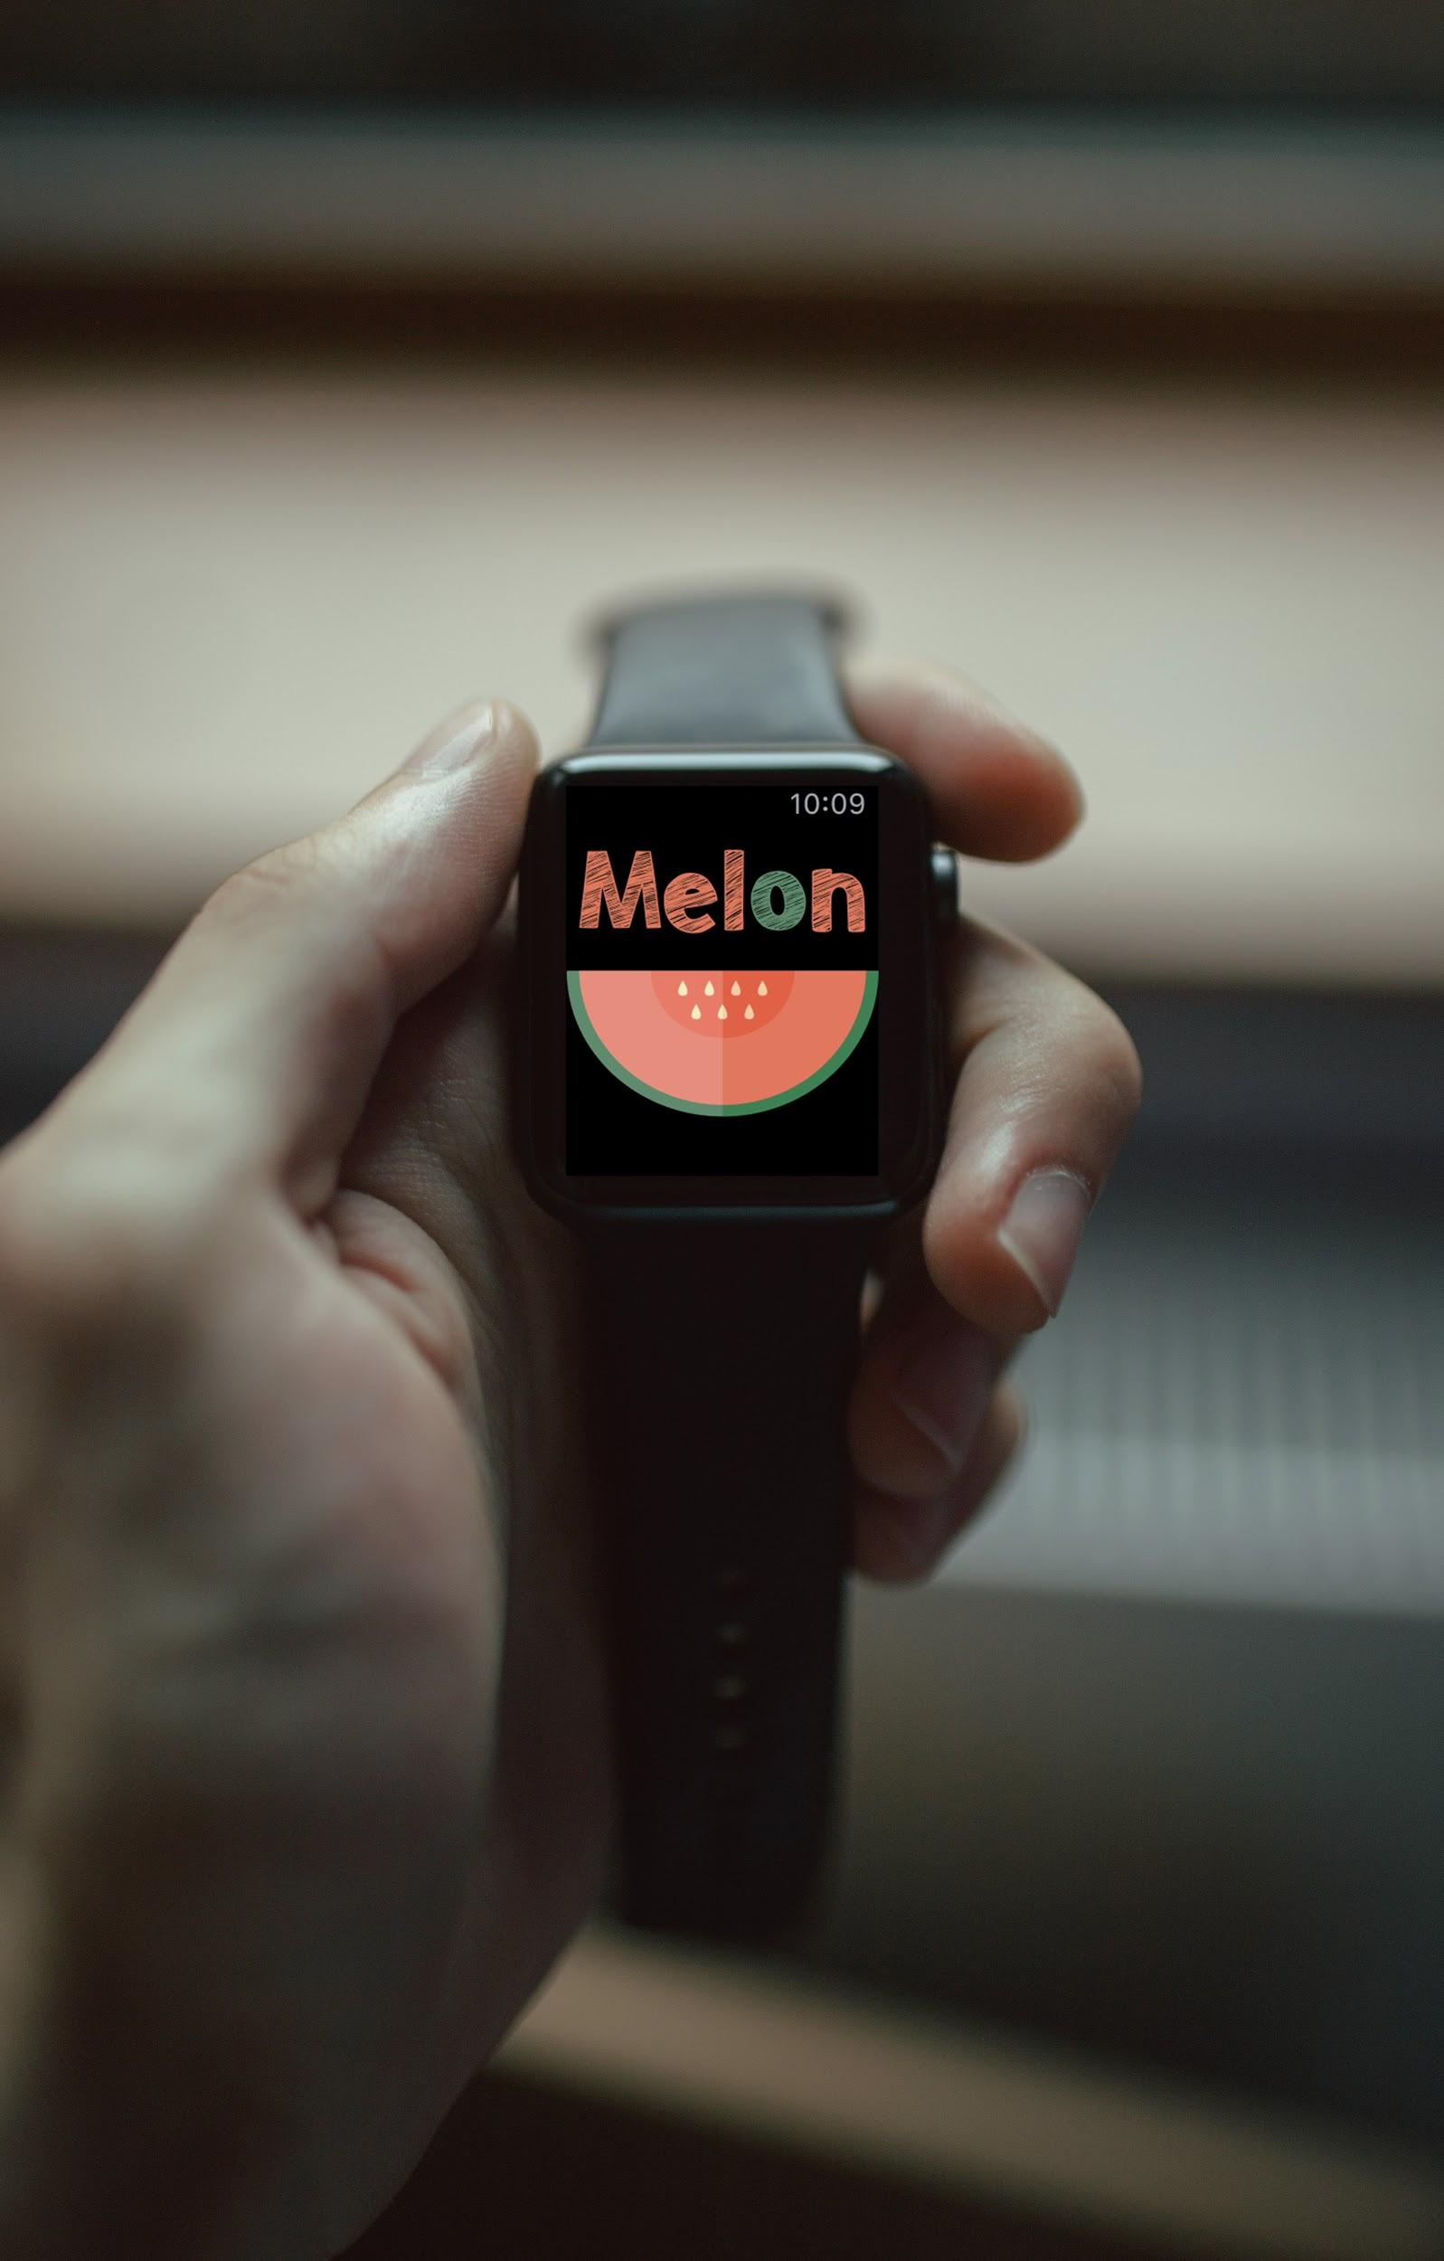
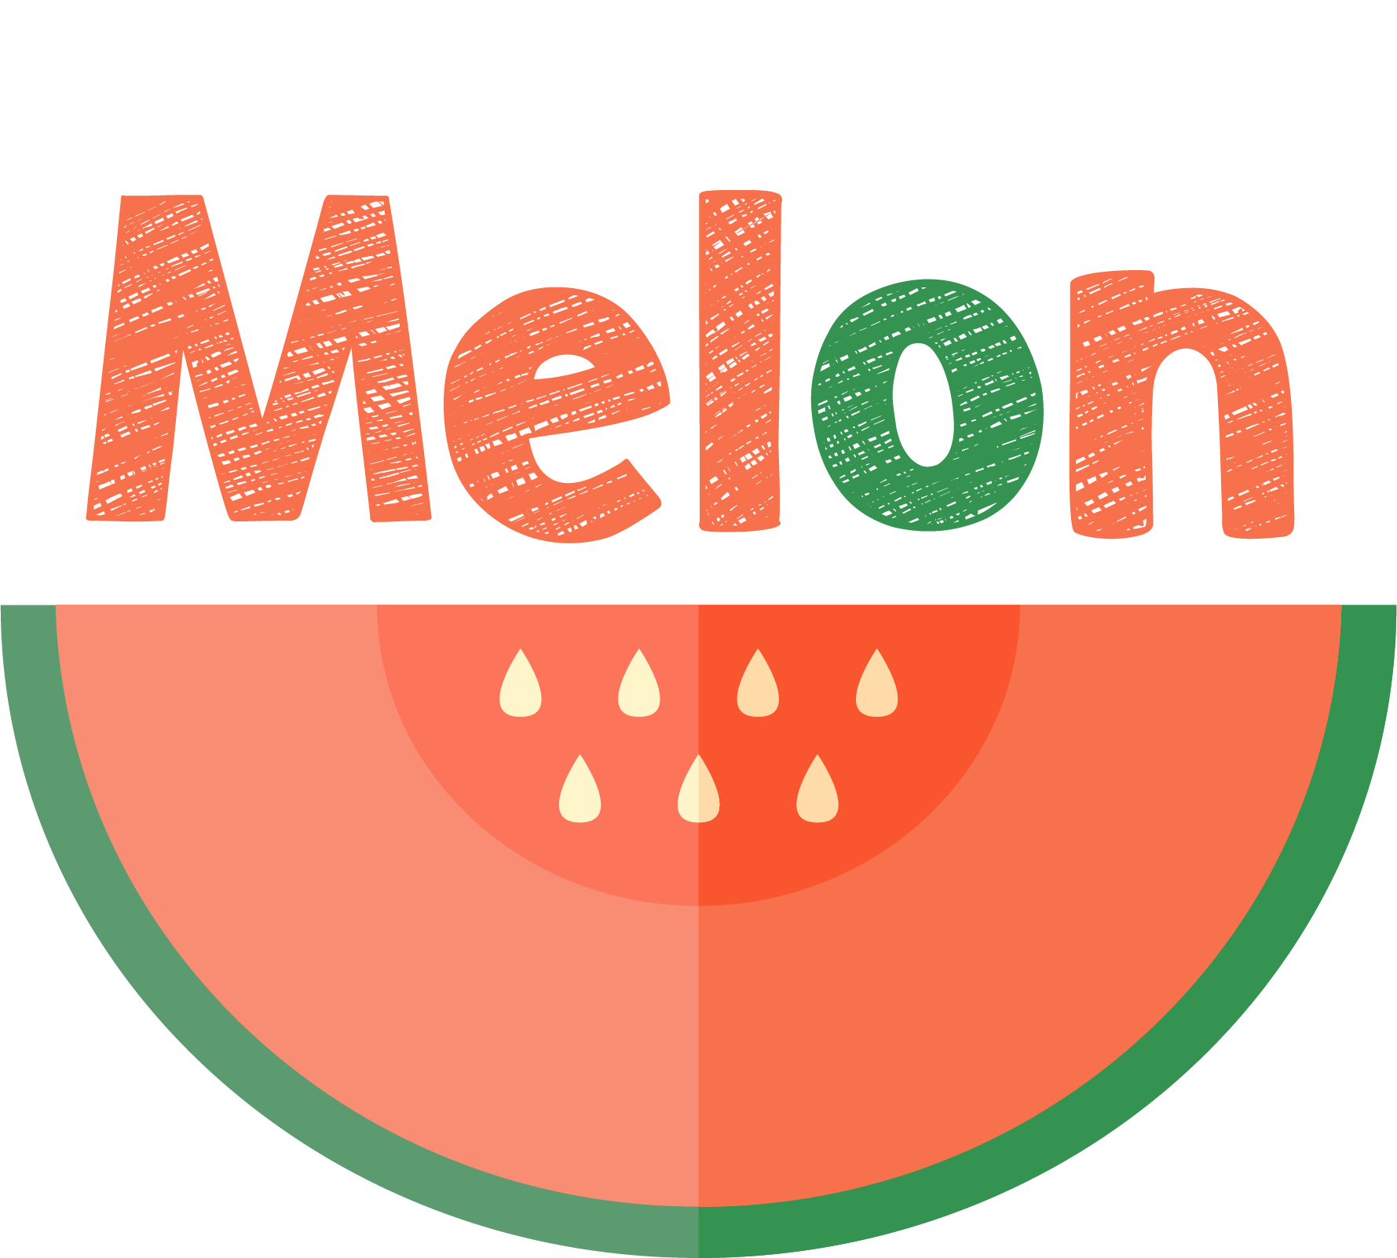
Put off your procrastination habit
Brandon Kim | Sylvia Wu | Echo Zhang

Slide 2
Do you have things you want to do but always put off...
Are there times you don’t know how to start on things so you wait until the last minute...

Slide 3

The Problem
Procrastination
Existing technology are designed for organized people
Procrastinators are losing control of their own time and life

Slide 4


Primary Tasks
Manage frequently procrastinated tasks
Make goals more manageable

Slide 5
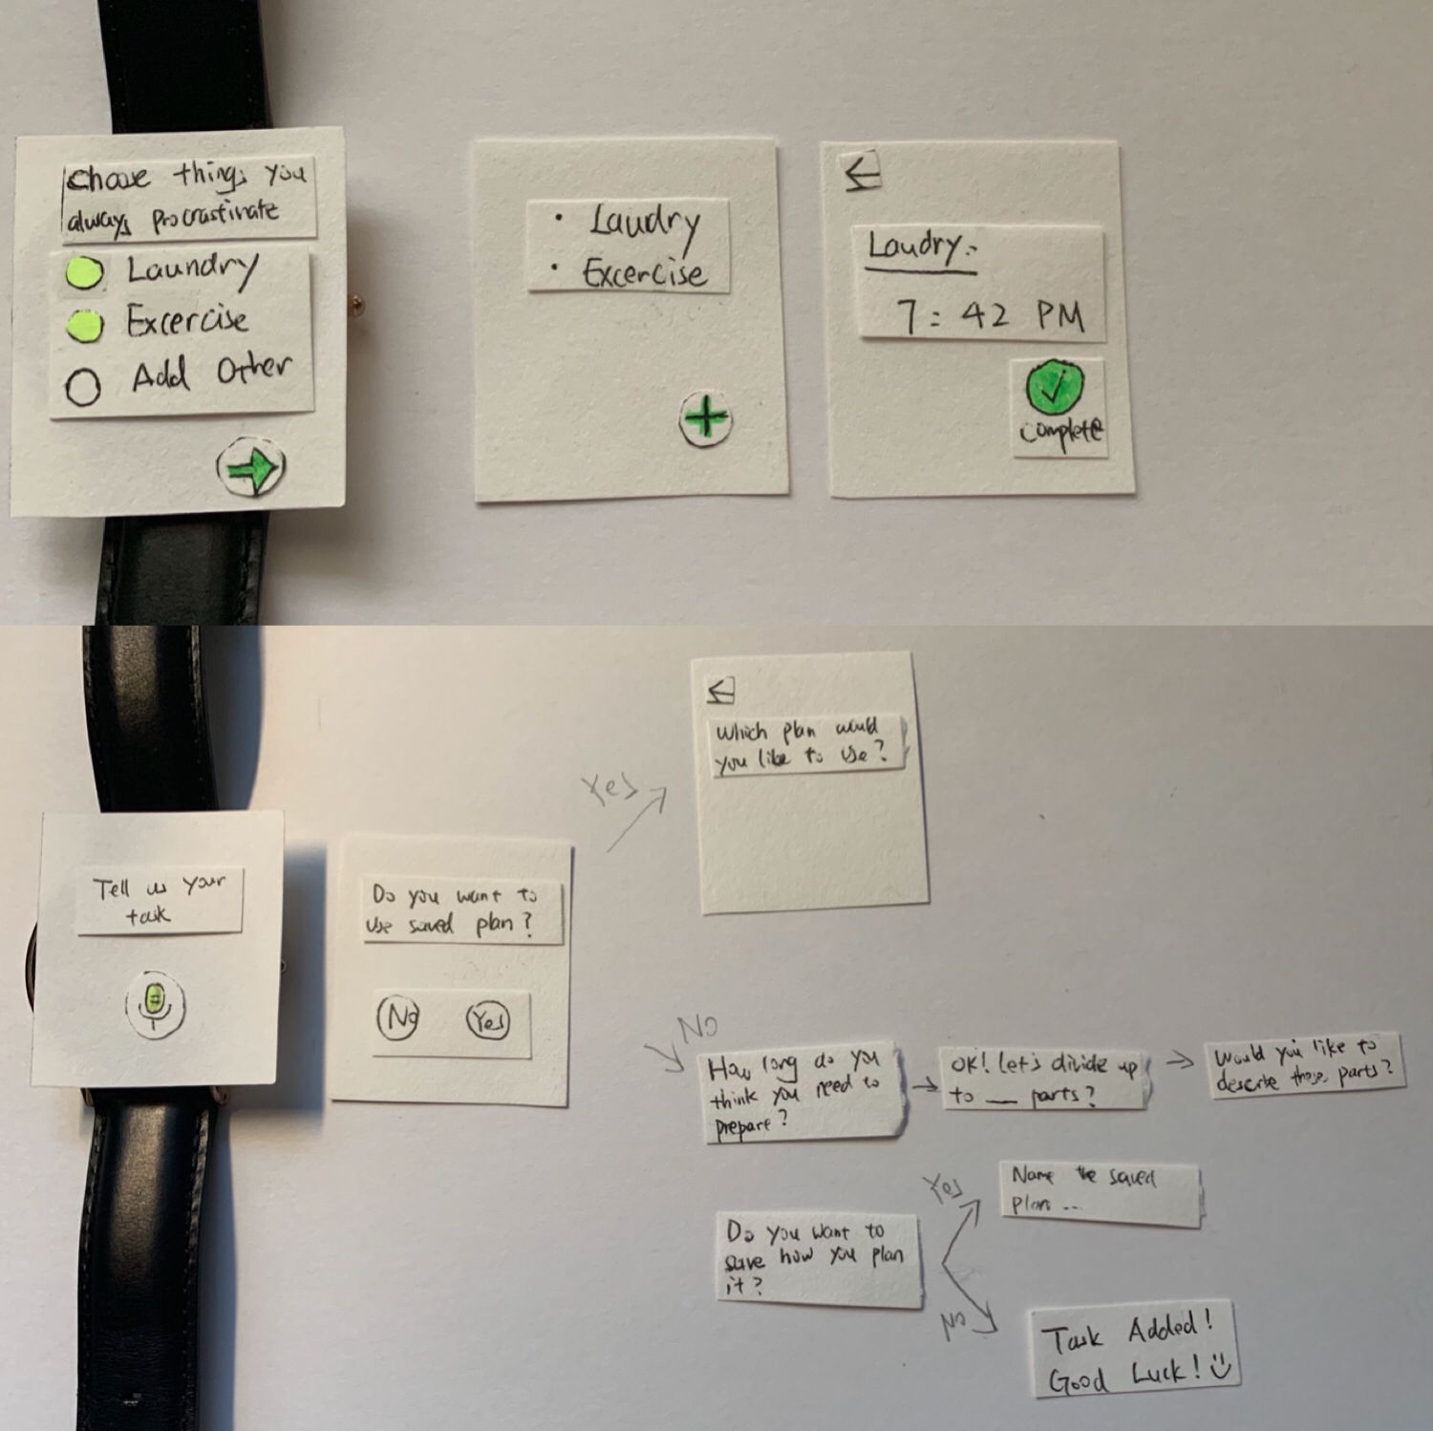
Initial Prototype

Slide 6
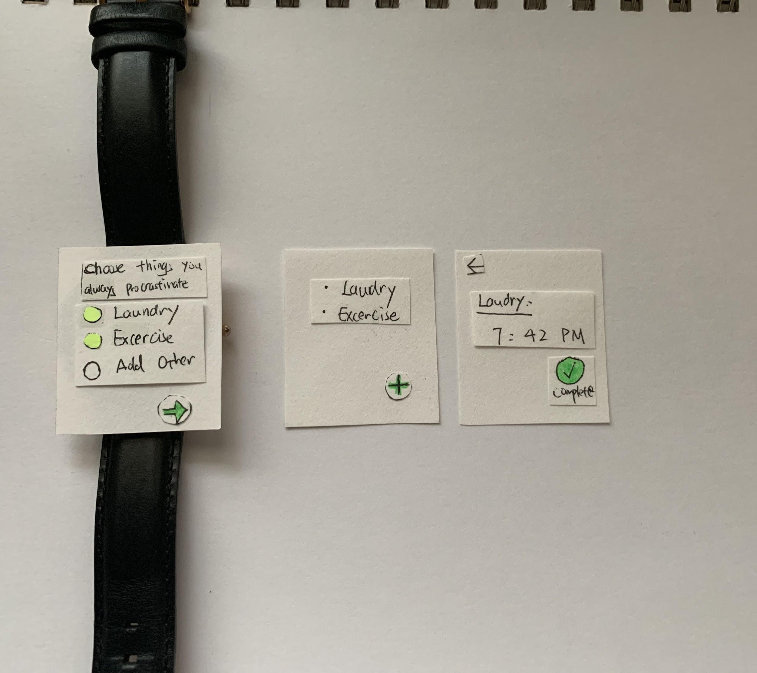
Task 1: Frequent Procrastinated Tasks

Slide 7
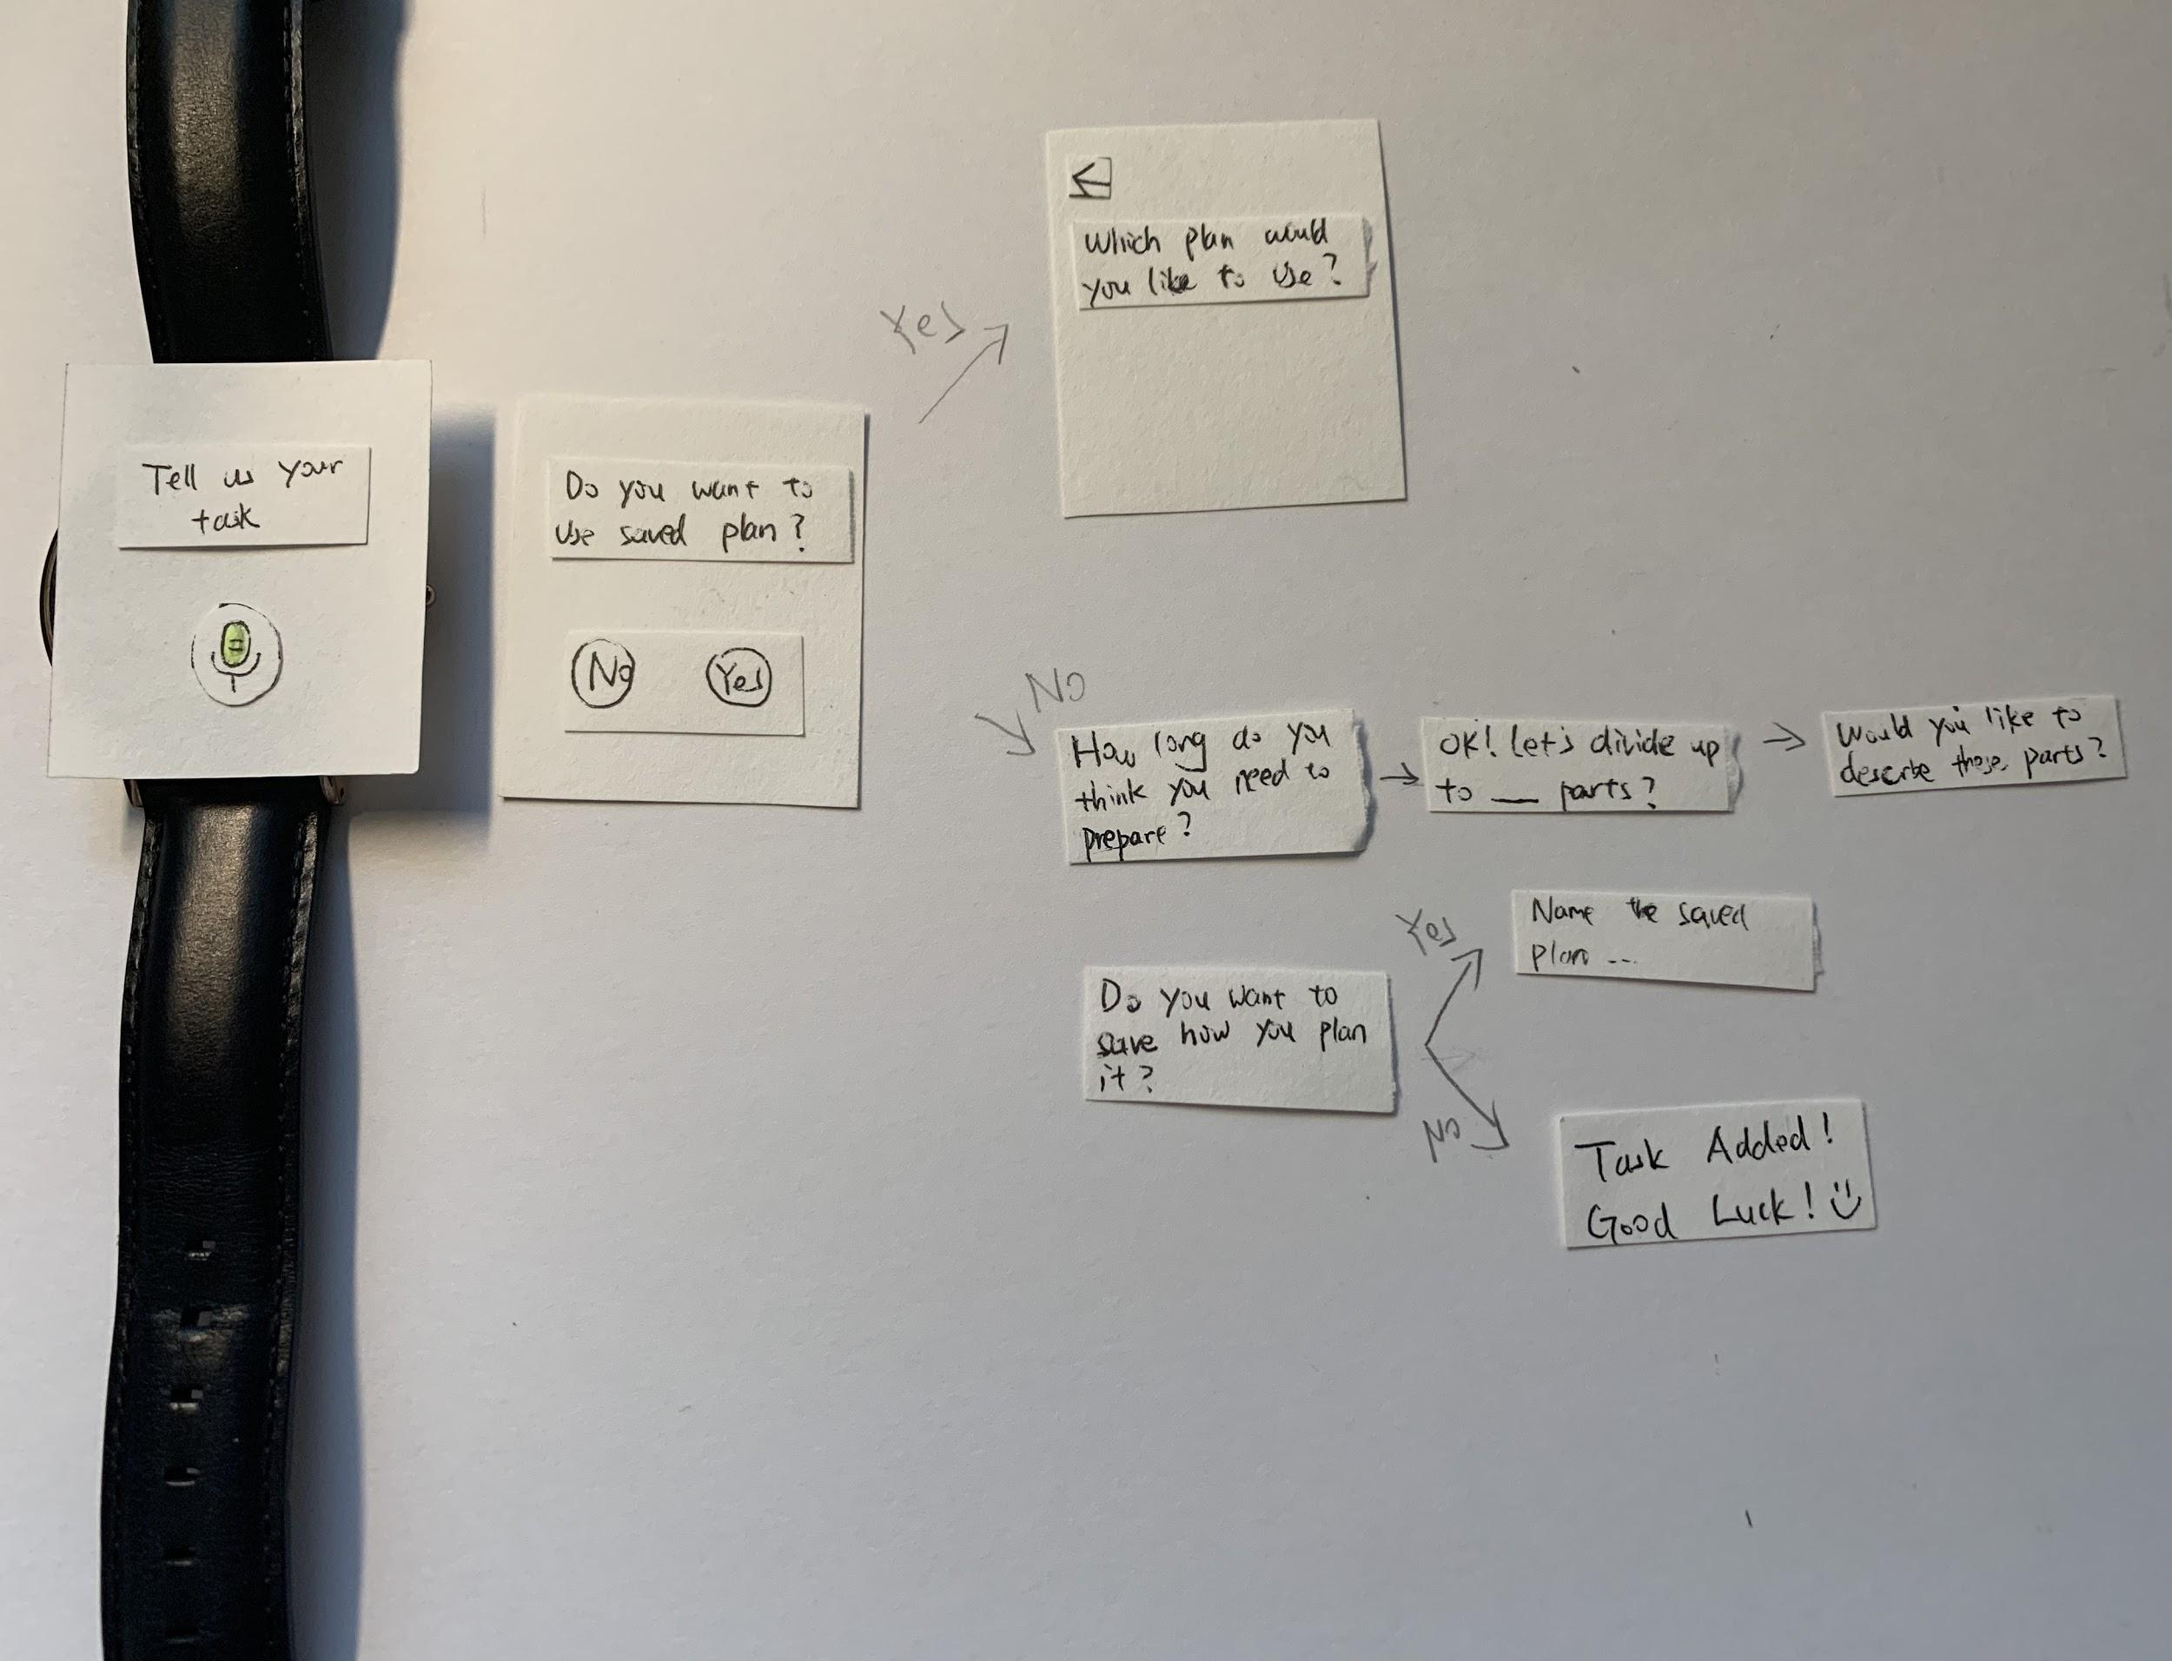
Task 2: Make goals more manageable

Slide 8

Testing Process
2 Heuristic Evaluations
3 Usability Tests

Slide 9
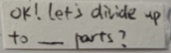
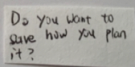
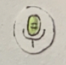
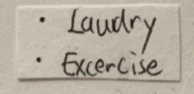
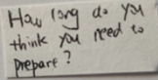
Heuristic Evaluations
Prompts are not specific enough
Status of the microphone button is not shown
Is the list clickable?
Can’t skip unwanted question

Slide 10
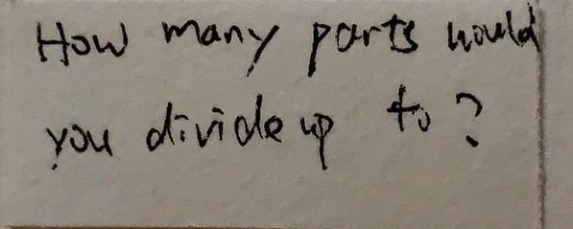
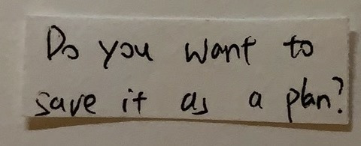
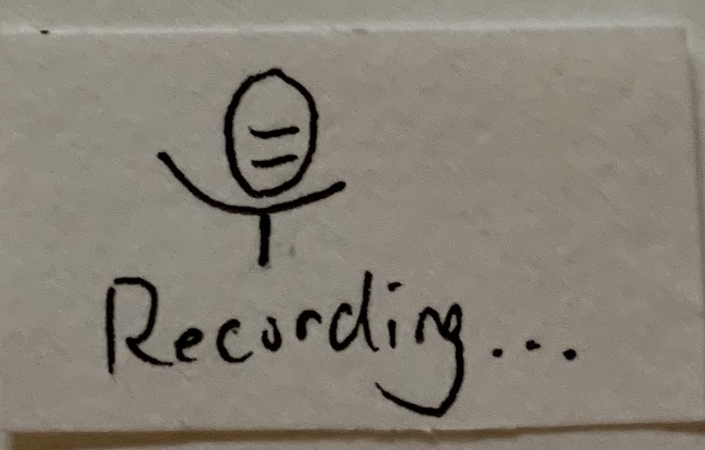
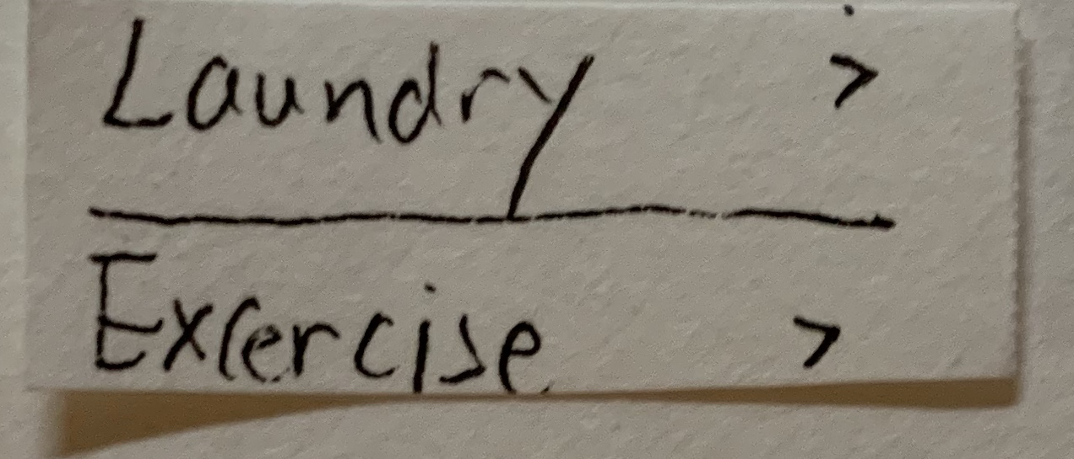
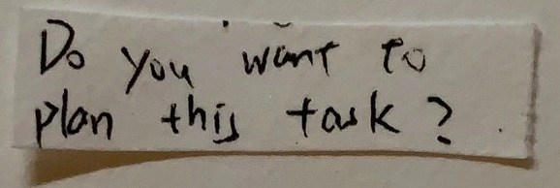
Revisions
Rephrased the prompts to be more specific
Made the status visible “Recording”
Added arrows to indicate it’s clickable
Allowed users to skip steps

Slide 11
Usability Tests
Scenarios:
Explore the app for the first time
Add a new task
Create a plan for the task / Use a saved plan for the task
Mark a task as complete

Slide 12
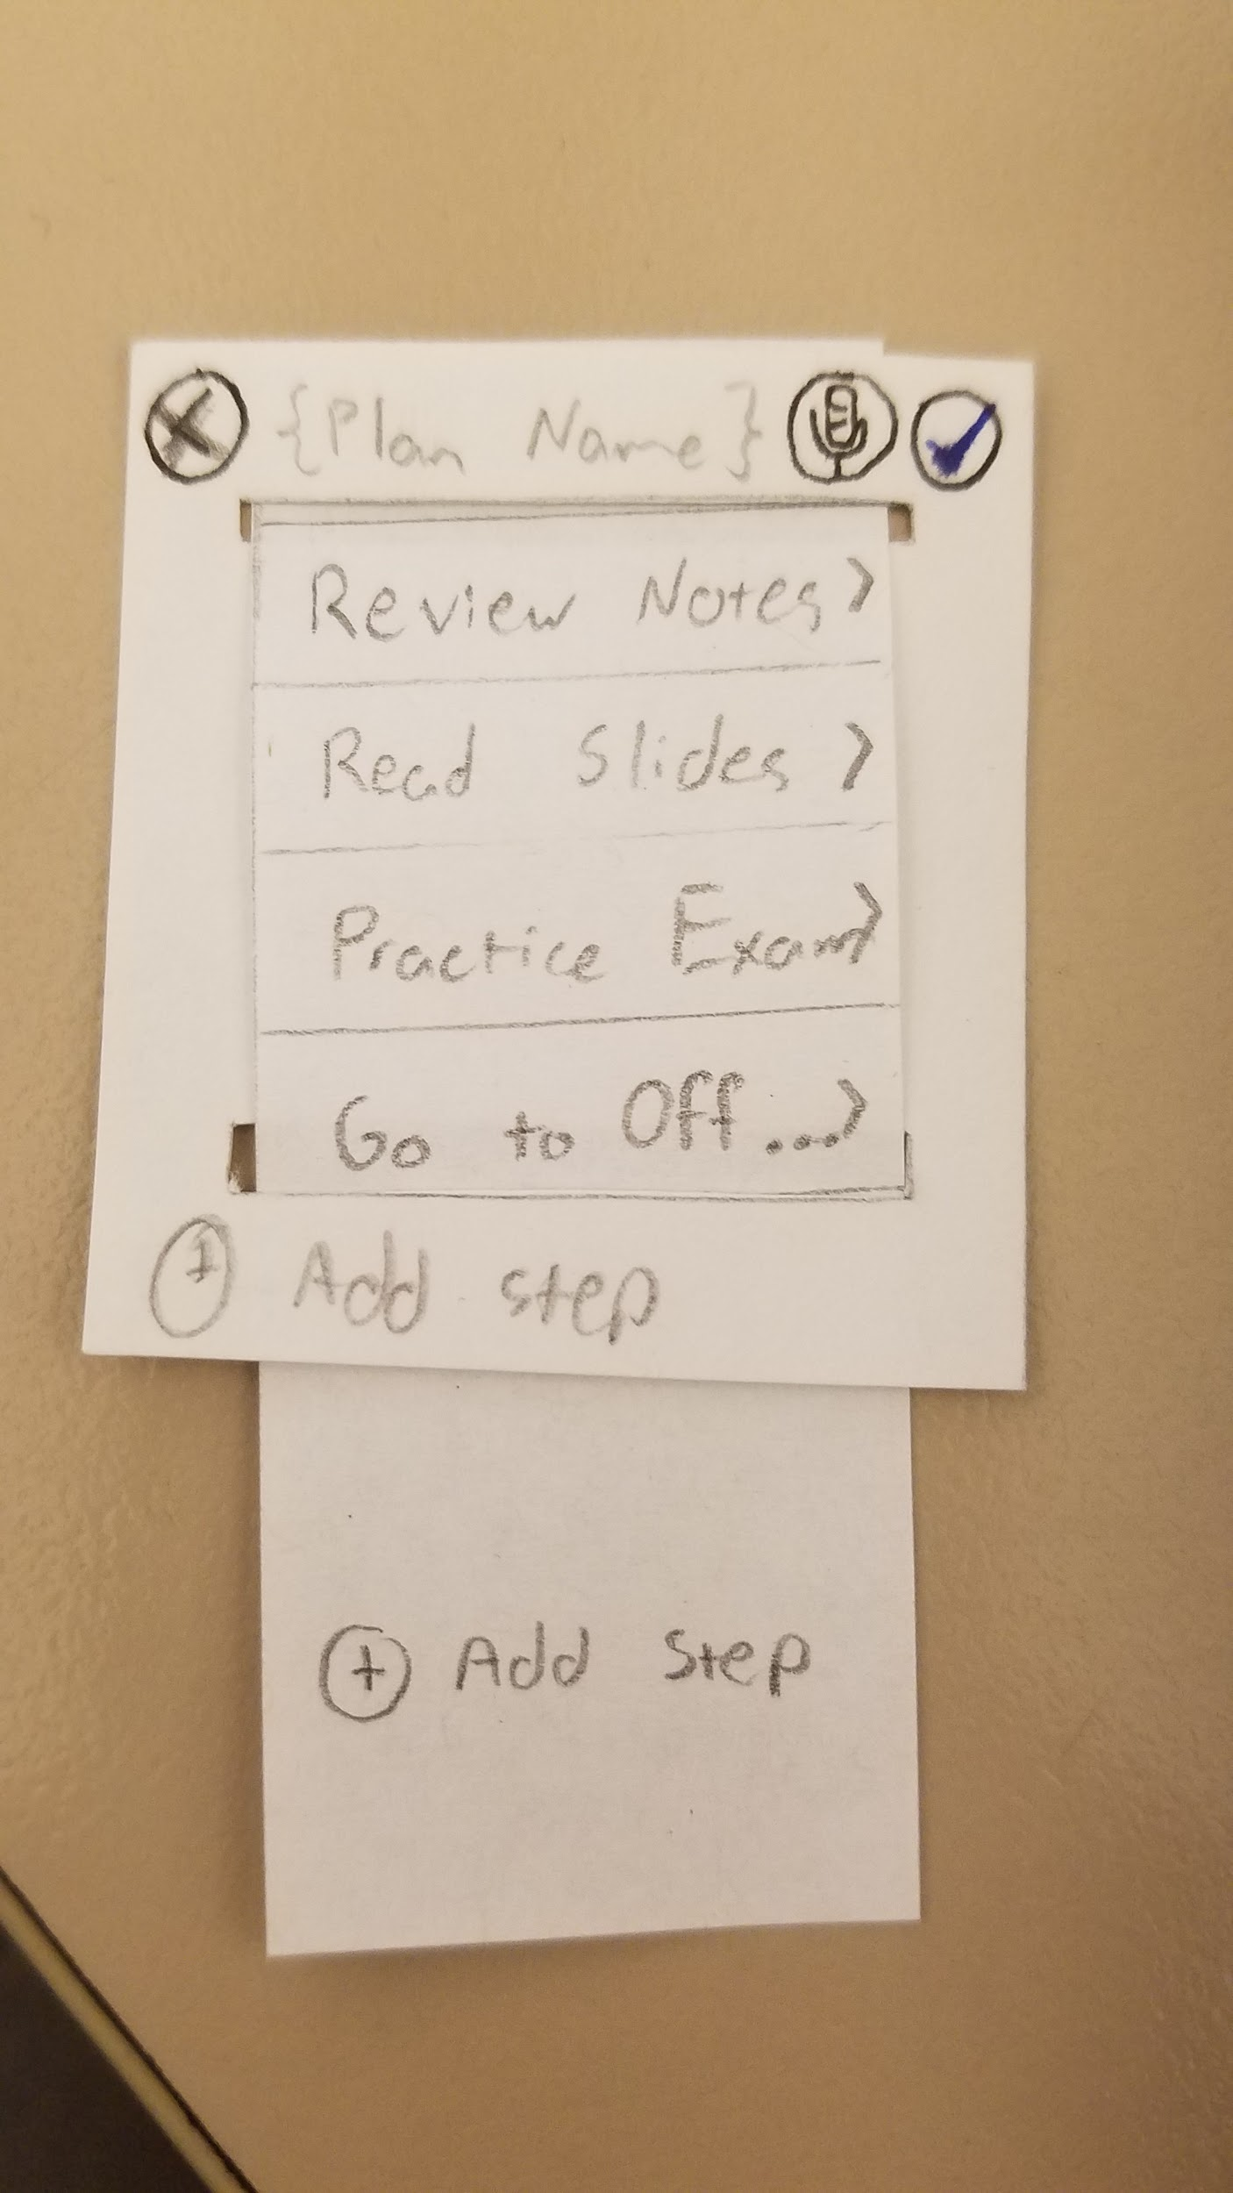
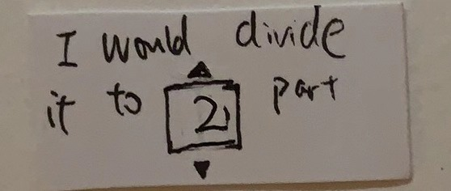
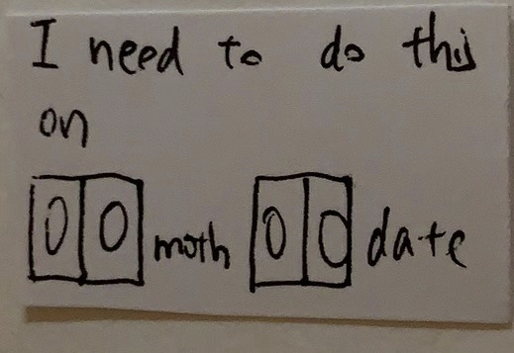
Test Results#1
Using voice input for a single number/date: Scroll bar
Users expected to plan step-by-step: List with items

Slide 13
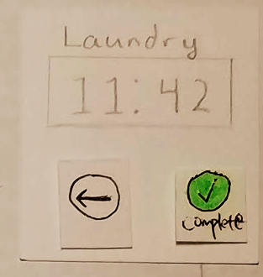
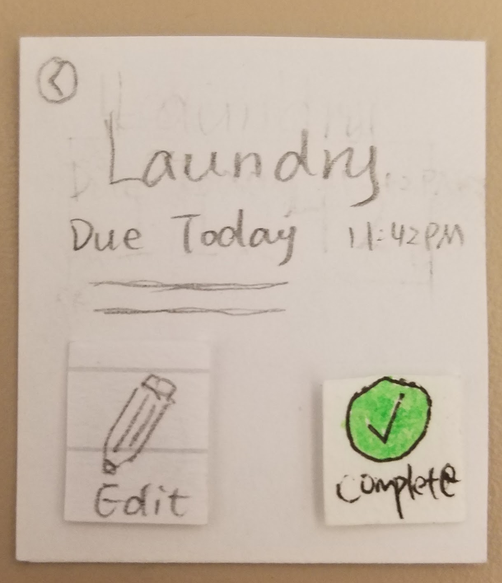
Test Results#2
Users expected ways to edit their tasks
We changed the detail screen and added edit feature

Slide 14
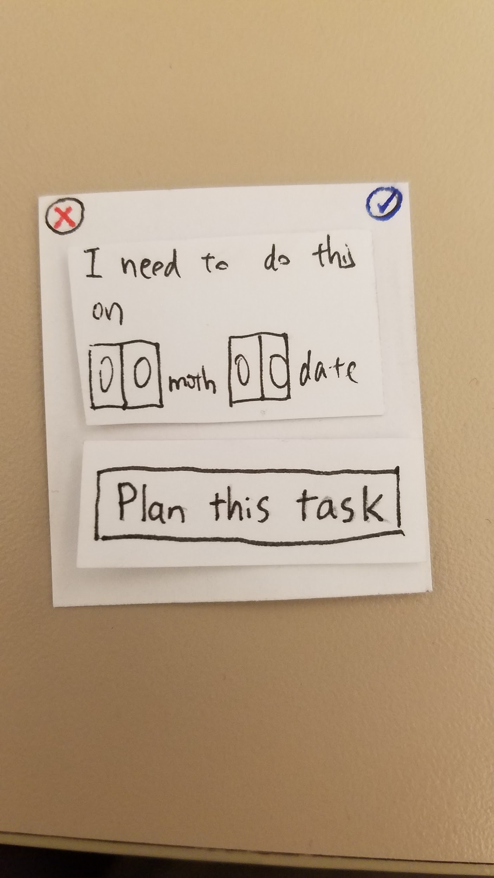
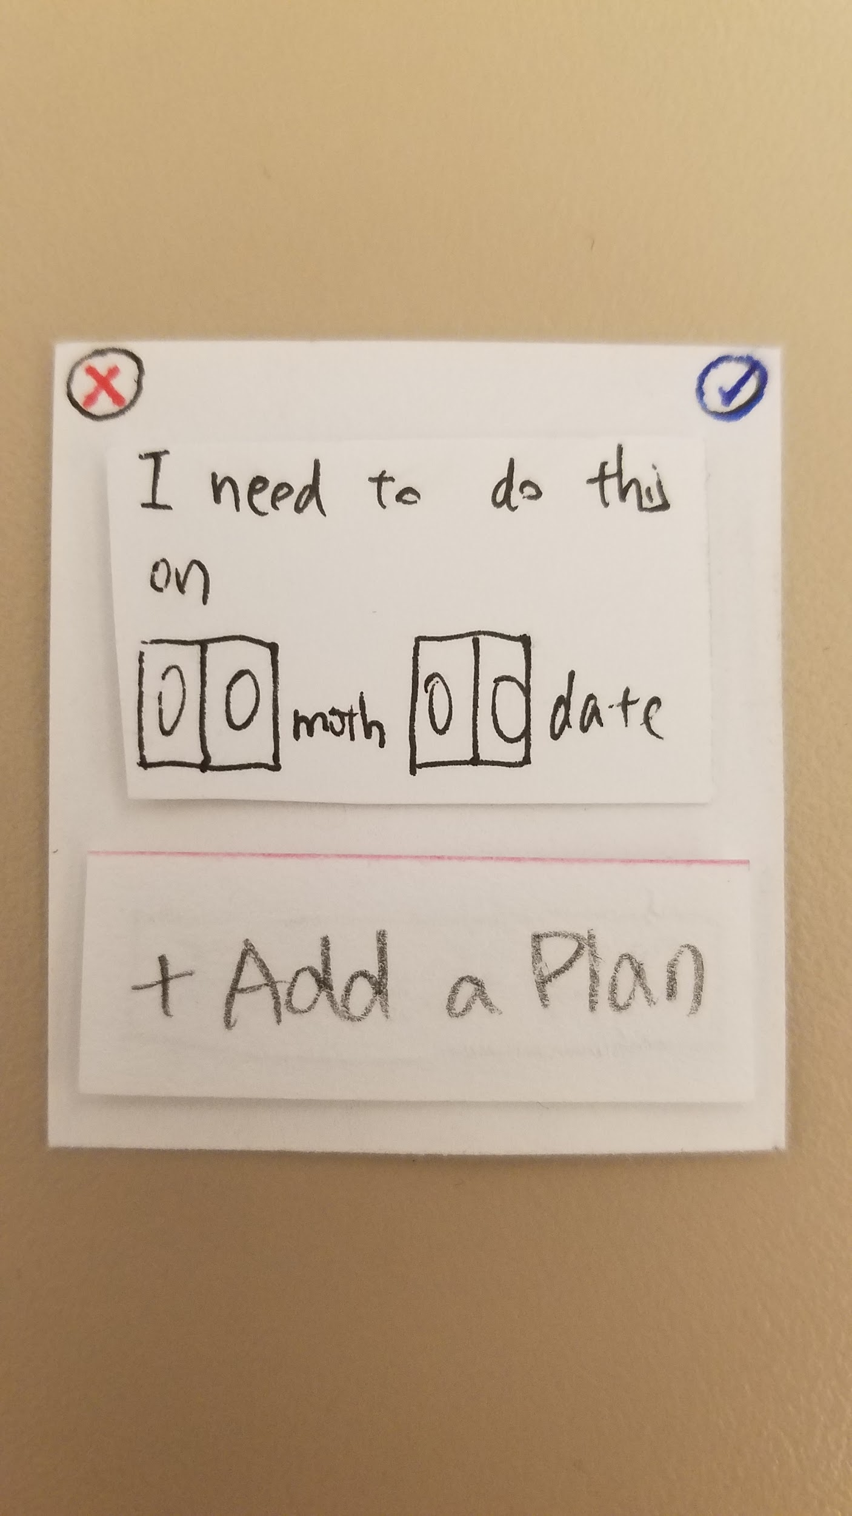
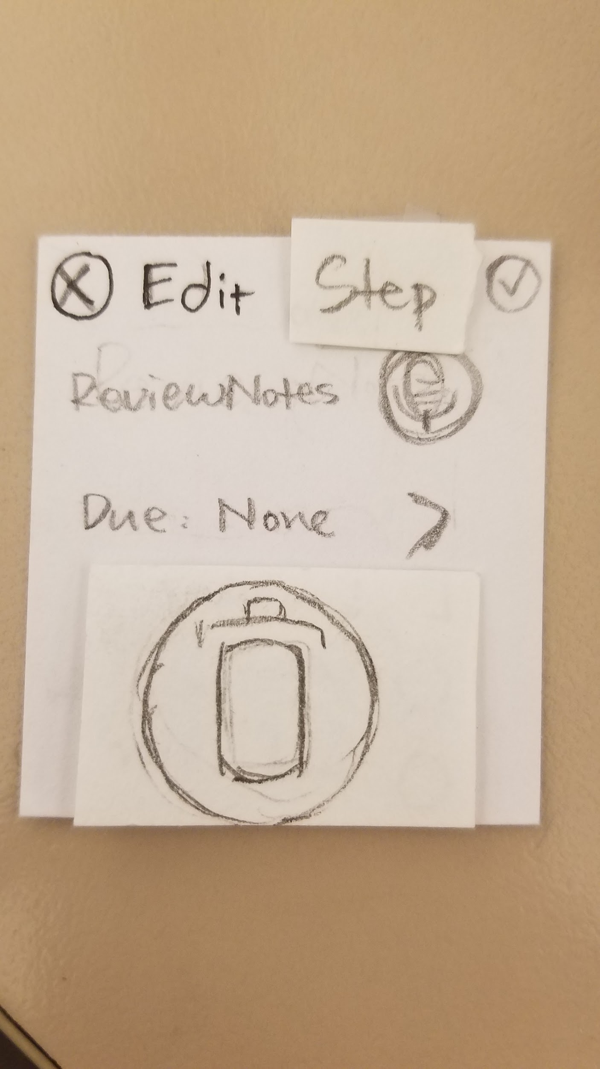
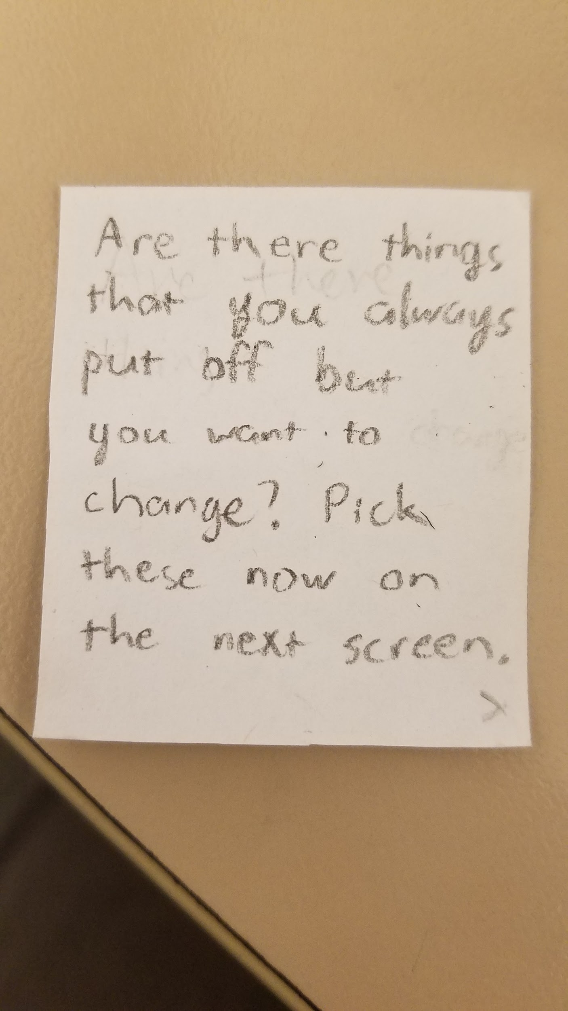
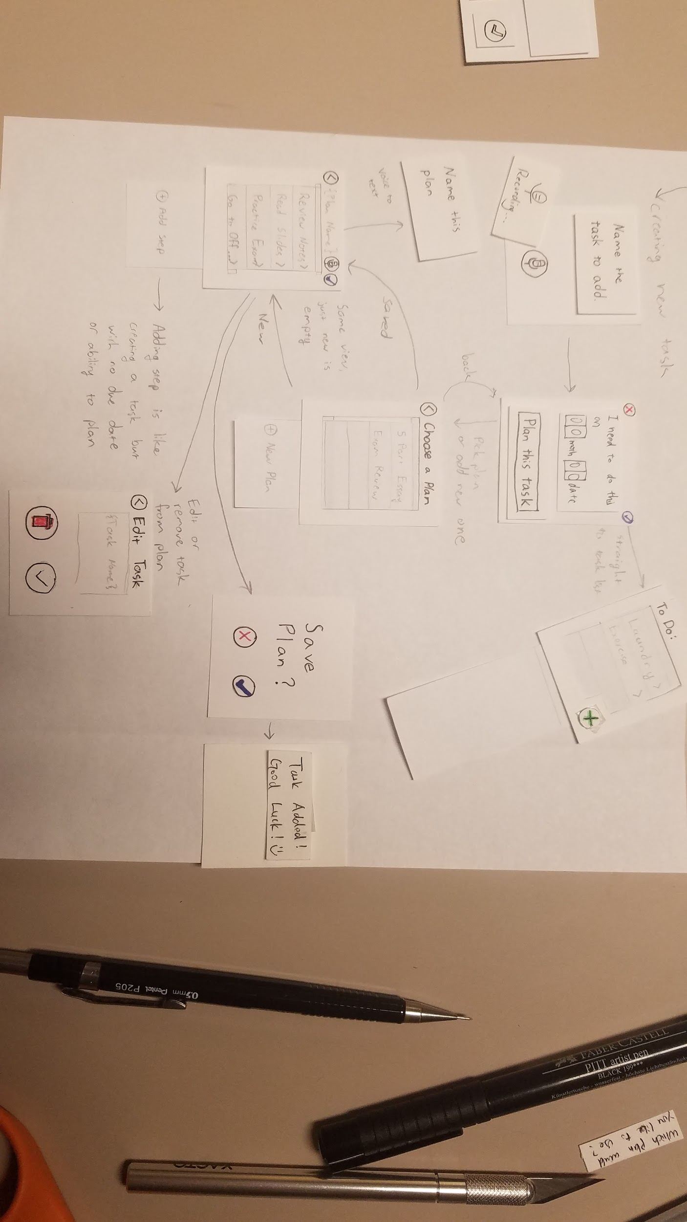
Test Results#3
Users were confused about some features and how to use them
Added icons and tutorials

Slide 15
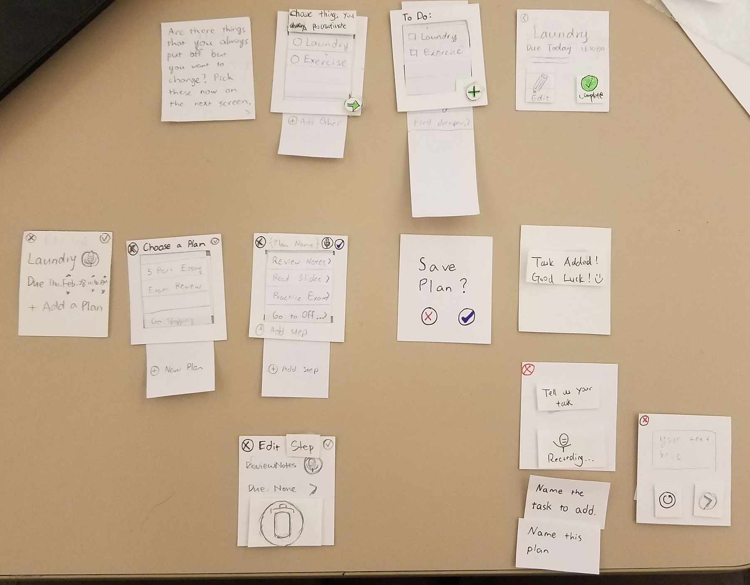
Final Paper Prototype

Slide 16
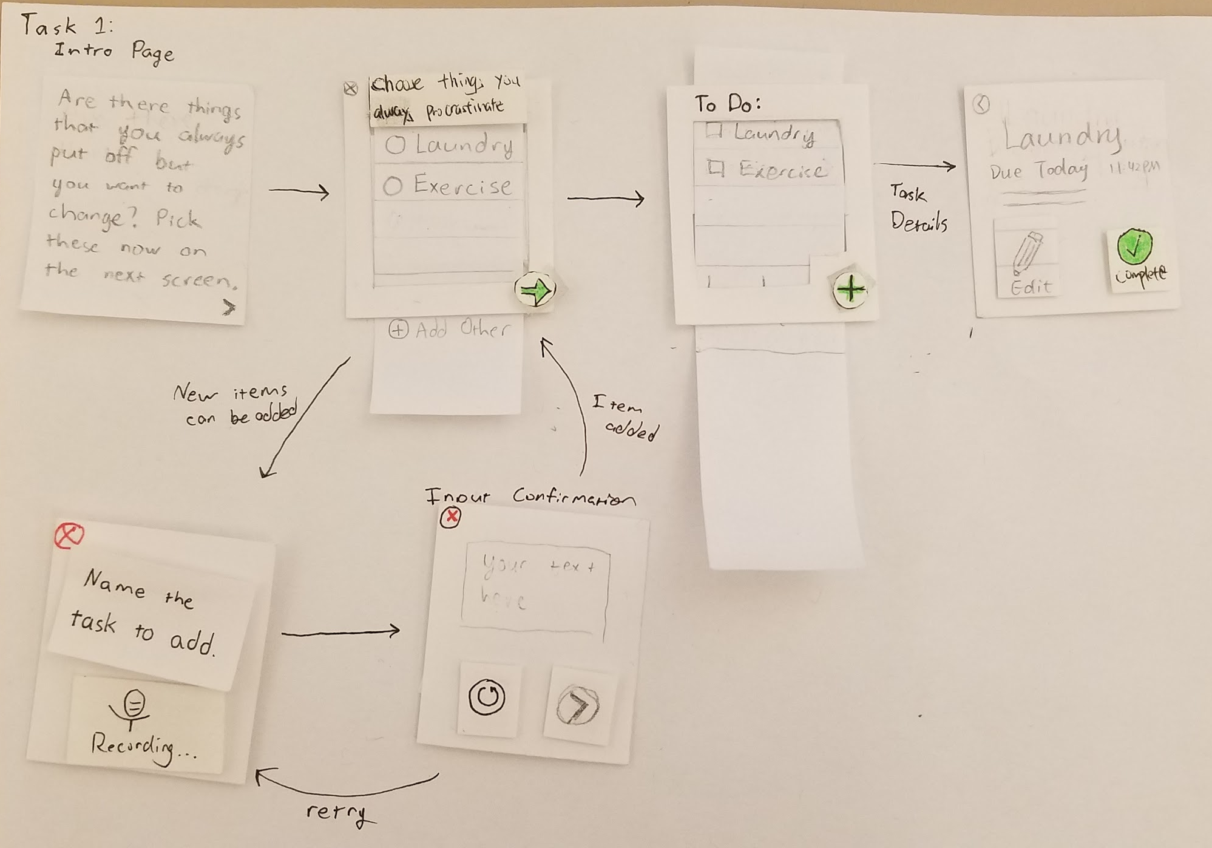
Task 1: Frequent Procrastinated Tasks

Slide 17
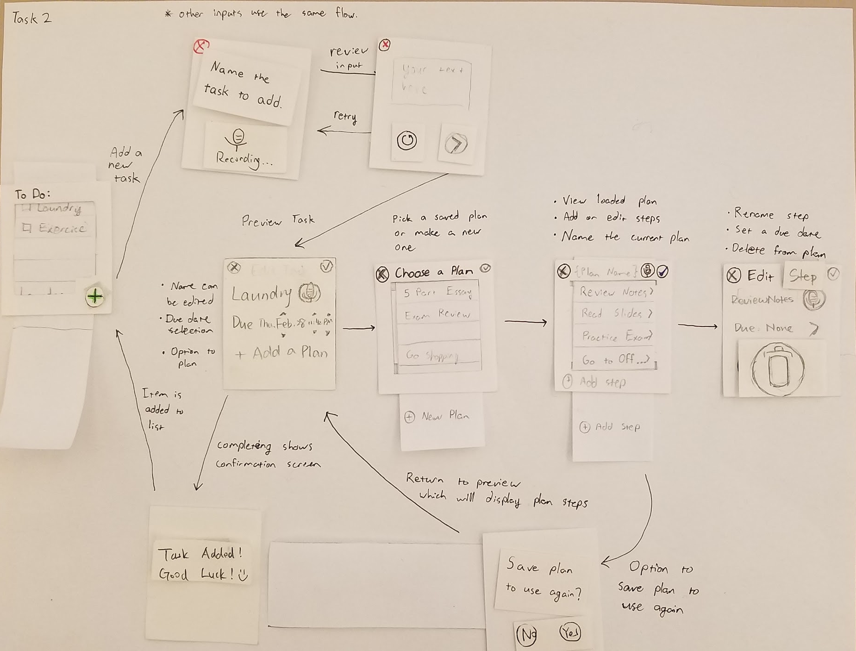
Task 2: Make goals more manageable

Slide 18
Digital Mockup
Manage frequently procrastinated tasks

Slide 19
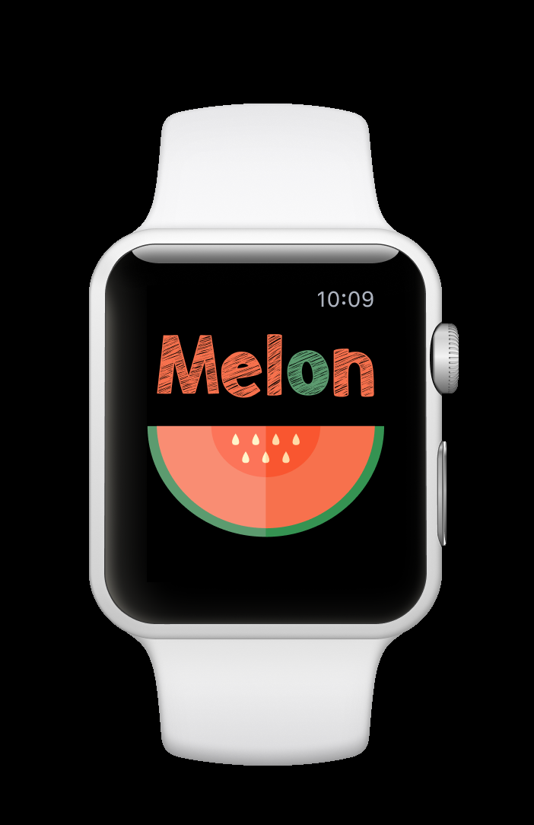
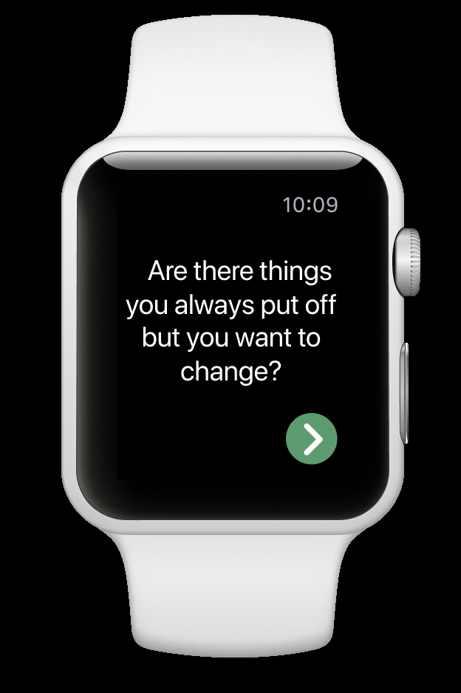
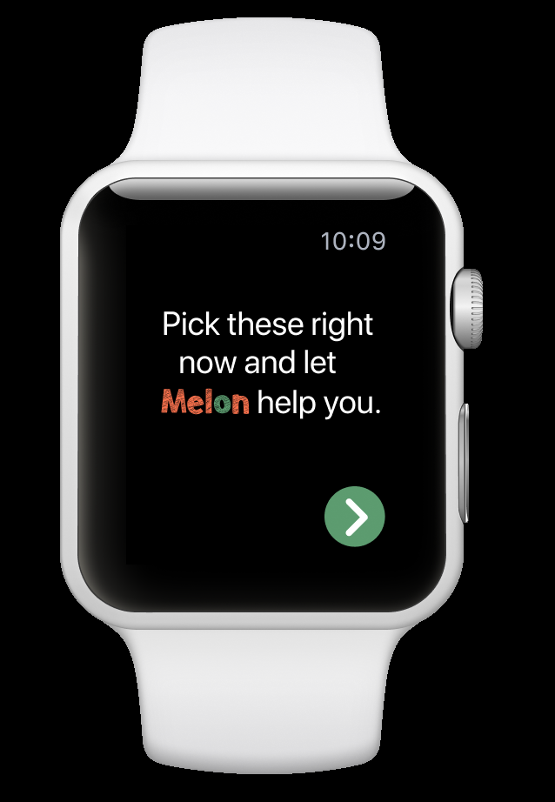

Slide 20
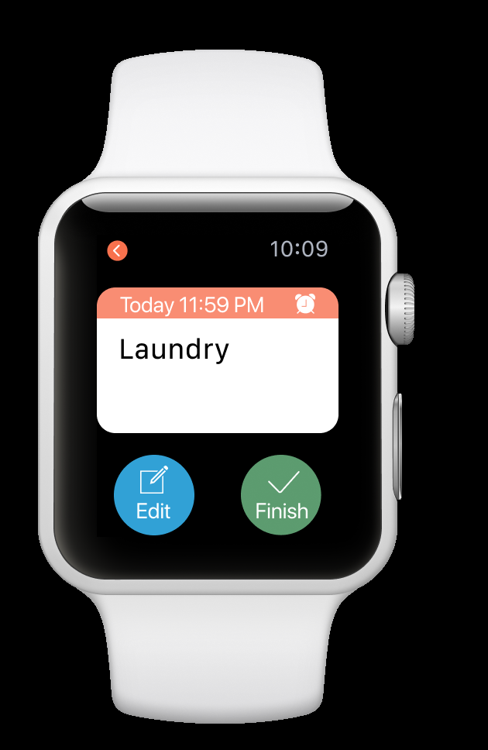
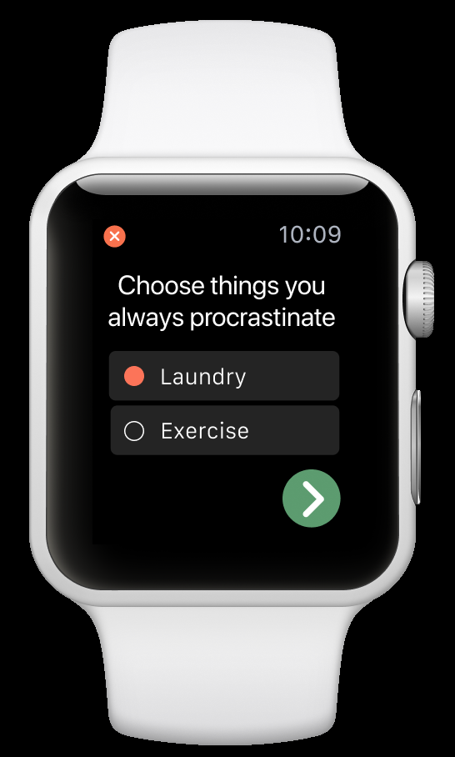
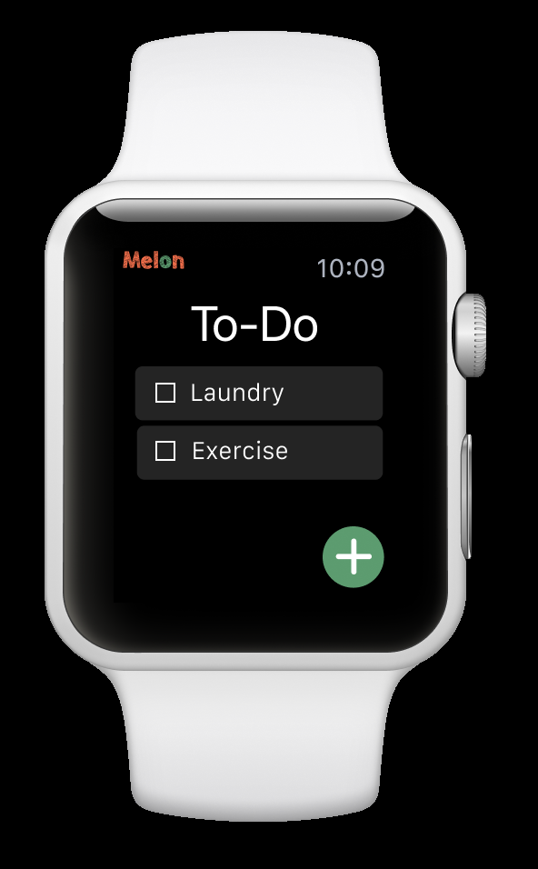

Slide 21
Digital Mockup
Make goals more manageable

Slide 22
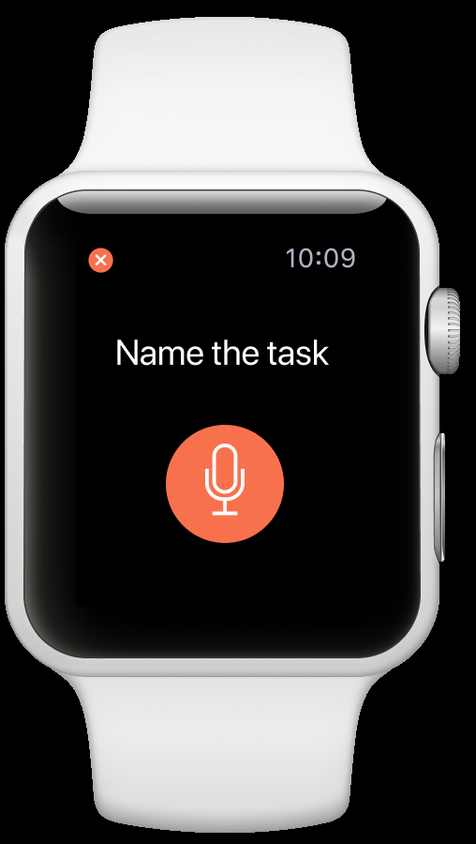
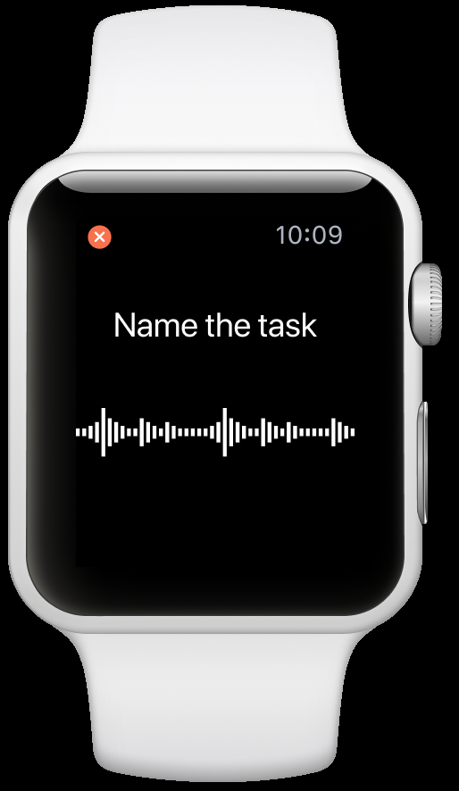

Slide 23
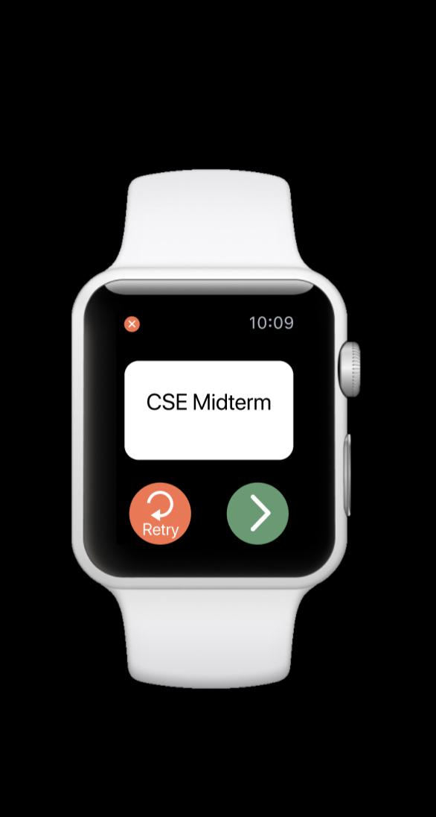
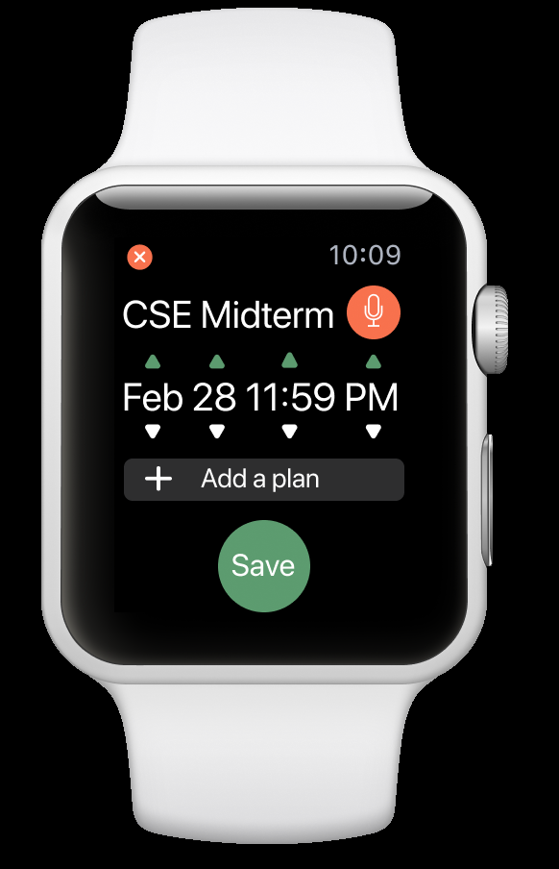
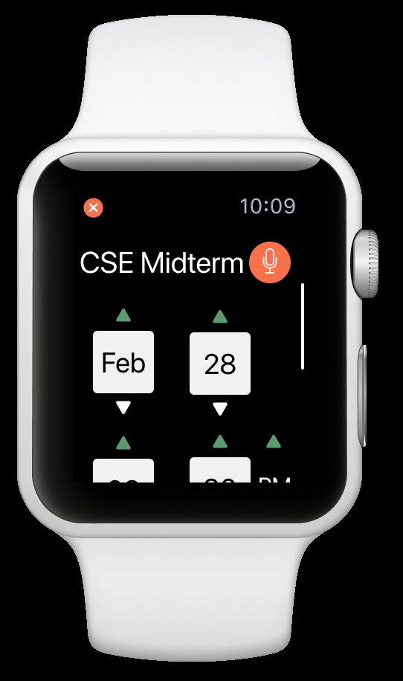

Slide 24
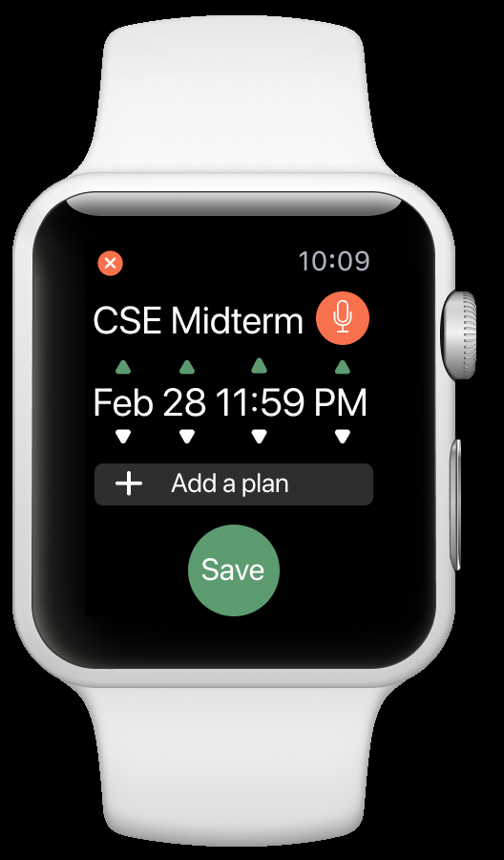
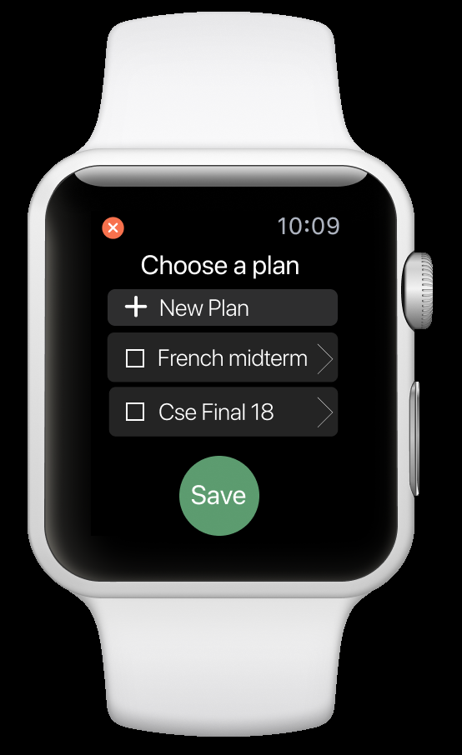
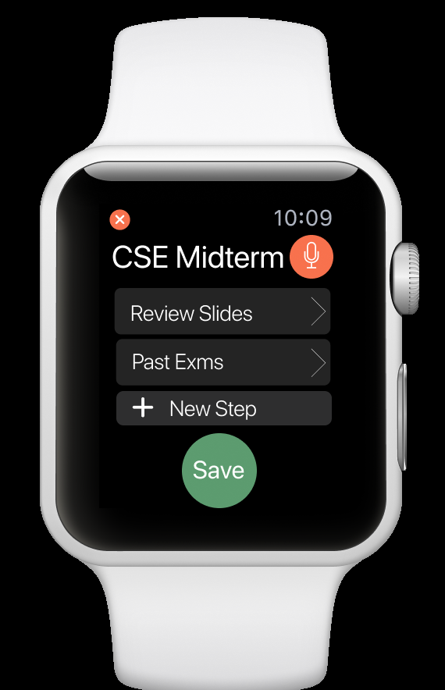

Slide 25
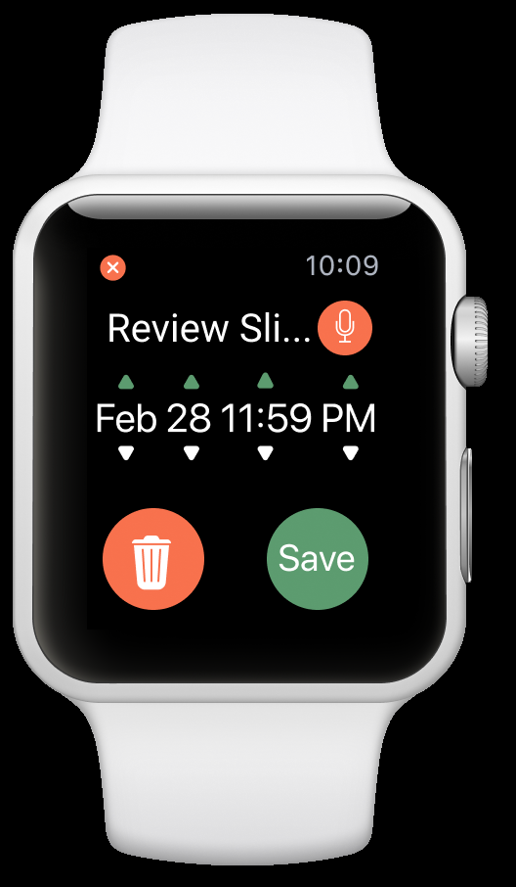
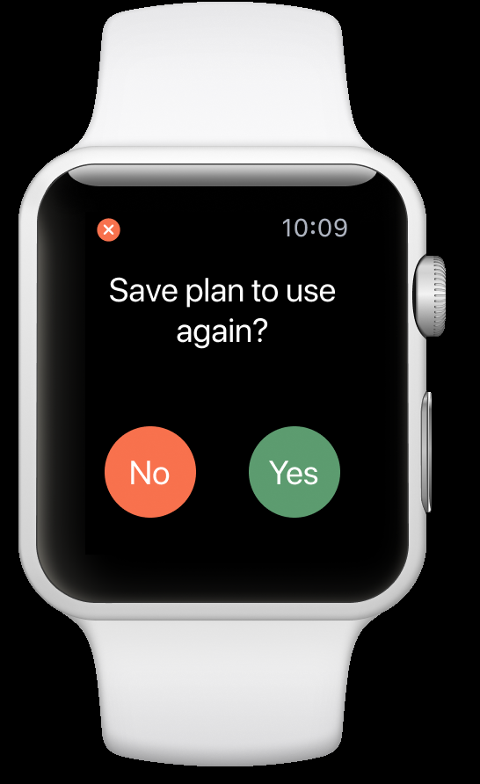
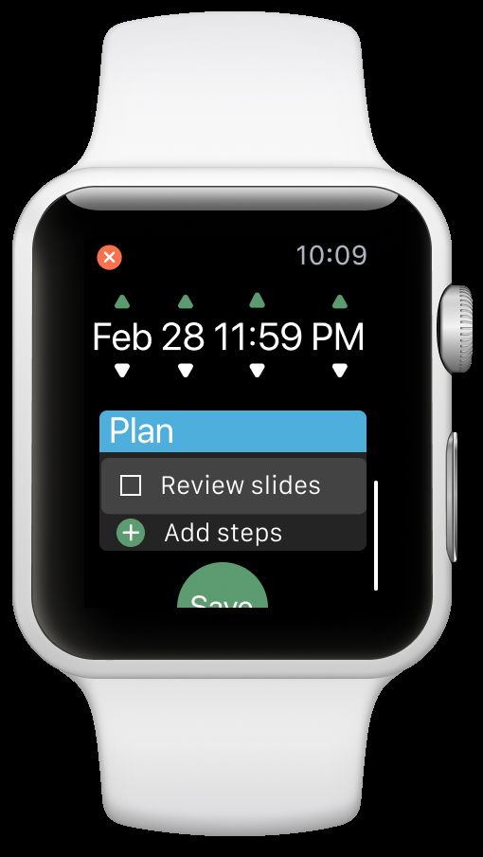

Slide 26
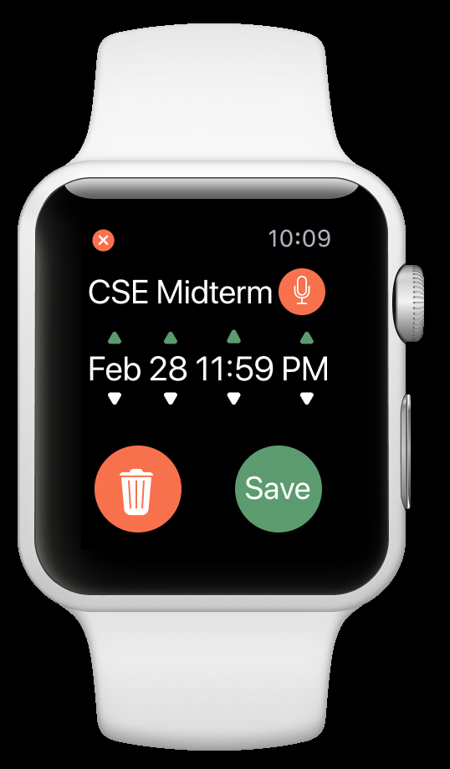
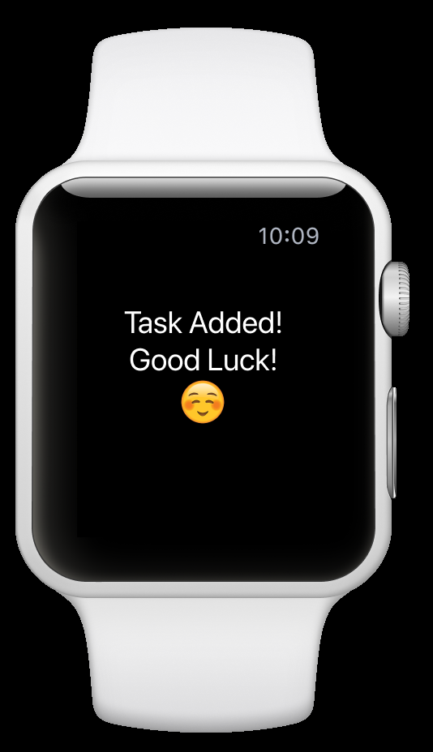

Slide 27
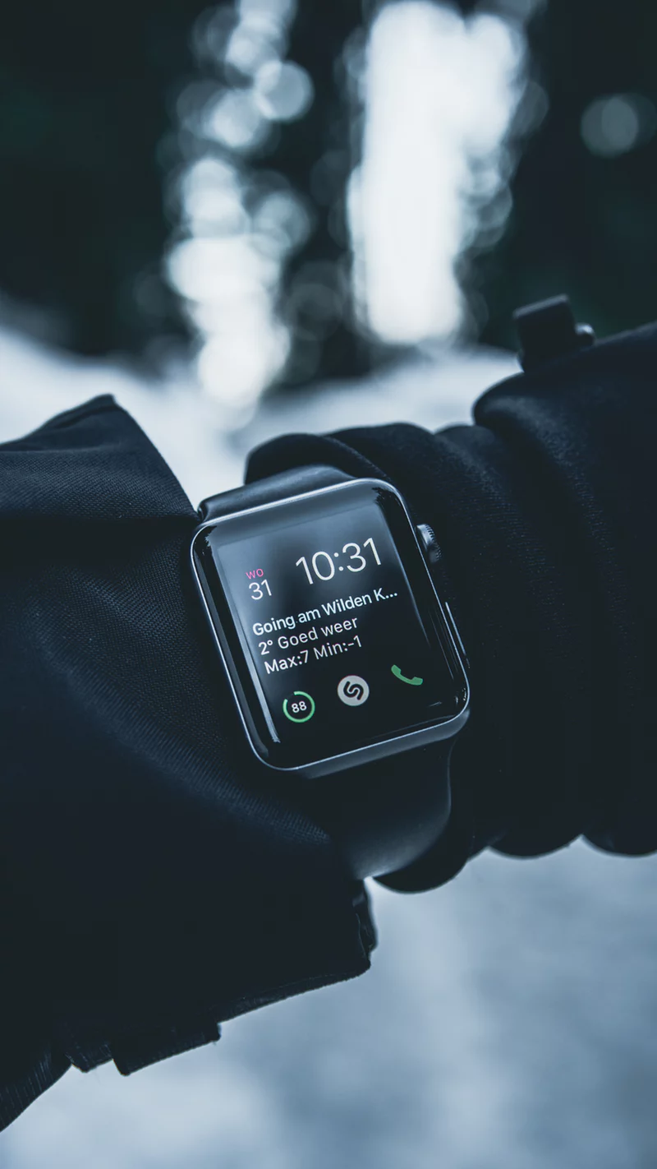
Summary
Narrowing down the scope is important, but we must consider everything a user might want to do
Paper prototyping allows us to change a lot
Usability testing helps us to realize the problems that we overlooked

Slide 28
Thank you!
Any Questions?

Slide 29
Contribution Statement
Sylvia Wu: 40% Present, Presentation
Echo Zhang: 35% Presentation
Brandon Kim: 25% Present

